Slide 1

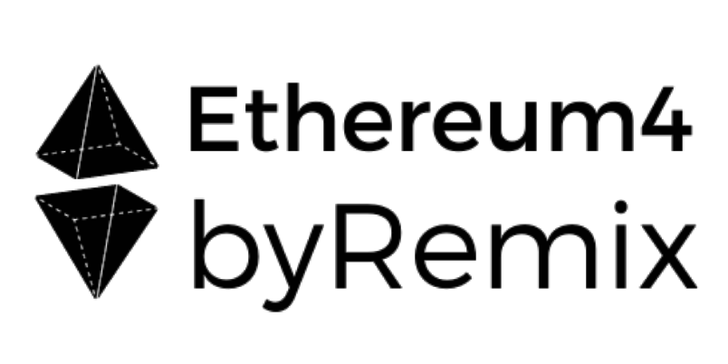
The Ethereum blockchain
and DAOs for Music Professionals and Communities
Workshop by

Slide 2
CHECK-INs

Slide 3
PLEASE
ASK “STUPID” QUESTIONS!
Notes:
There are no stupid questions
Raise your hand

Slide 4
FEEL FREE
TO
CONTRADICT
Notes:
There are no stupid questions
Raise your hand

Slide 5
BLOCKCHAIN
CAN BE A COMPLEX
SUBJECT...
Notes:
I will run this first part of the course which is dedicated to my personal experience as a musician going crypto.
Blockchain is a complex subject. Everyone talks about blockchain, bitcoin, ethereum, but do we really know what it is about?

Slide 6
...BUT MUSIC ECONOMY
CAN BE AN EVEN MORE
COMPLEX SUBJECT.
Notes:
Music is the only industry based on an immaterial, invible content
lightweight, has social impact
compared to images and movies, allows multitasking (you listen to music while running, working, shopping, cleaning).
Copyright and royalties system connected to publishing is one of the oldest system (Mozart)

Slide 7
E.G. COMPLEXITY OF AUDIENCES TODAY
STREAMING NOT PREMIUM
RADIOs
FREE
LISTENERS
PHYSICAL COPIES
PREMIUM STREAMING
PAYING
LISTENERS
ARTIST MERCHANDISE
ASSIST PROMOTION on SOCIAL MEDIA
FANS
INFLUENCERS
COVER BANDS
EMULATORS
ORGANIZATIONS OF FANS
SPECIAL STATUS
FANCLUBS
Notes:
Innovating in music means being aware of all the pieces we have on the chessboard, what their value is and what actions and strategies they can implement

Slide 8
WHAT IS MUSIC ECONOMY MADE OF?
fresh ideas | old outdated structures
platforms live shows merch | IP rights mgmt metadata
communities social currencies | collaboration

Slide 9
ELEMENTS IN MUSIC ECONOMY
Manufacturers Musicians
Managers Audiences
Sponsors
TRIBES
Patents
Copyrights Royalties
Physical formats
Digital formats Tickets
Streams/plays
ASSETS
Devices
Services
TOOLS
Online
Offline
SPACES
Production
Promotion
Logistics
Performance
Feedback
Curation
ACTIONS
Notes:
TRIBES
Instruments Manufacturers and Software houses, Retail (thomann, Amazon)
Musicians: session musicians, singer-songwriters (bands, solo artists, collectives), teachers
Middlemen: studios, videomakers, management, booking agents, labels, distributors (tunecore, distro)
Third Parties: Instrument brands, merchants on YT/Spotify, purchasers of data
ASSETS:
(...) Numbers: streams, followers, concert-goers
SPACES:
Online: aggregators / streaming platforms, youtube, twitch
Offline: Live venues
INTERACTIONS
One to one: musicians and management/venue
One to many: Musician/band to fans
Many to Many

Slide 10
PRE NAPSTER
MUSIC PIRACY
Notes:
In order to be able to understand what the blockchain can offer to music professionals, we must analyze some aspects in the history of music industry.
In fact, some concepts we may want to apply to music on the blockchain might derive from past examples.
So the first historical block I decided to call it “Pre Napster” WHY? Because I could have divided analog music from digital music, but when we consider CD in the 90s we are talking about digital music supports that are still marketed in the analog industry (physical copies, shops etc.)
WHY “ECONOMY” AND NOT “INDUSTRY” → Industry too often does not take into account the Immaterial Value, Economy does.

Slide 11
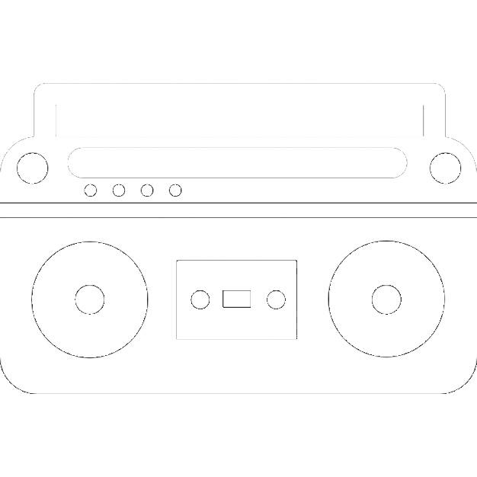



ANALOG MUSIC PIRACY
MIXTAPES
PIRATE COPIES
FOR SALE
PHYSICAL ITEMS
TIME INTENSIVE
MUSIC SWAPPING
AUDIO LOSS
PROS
CONS
BROADENING THE FANBASE
SCALABILITY
Notes:
Why we look at Piracy?
Piracy is something the Industry looks at very carefully: they shut down whoever might get too big, but never kill the movement.
Records always display “copying is a copyright infringement”, the audio technology market is based on copying (tape decks, blank Cassettes for mixtapes etc).
DJs needed to have authenticated copies, they could not play pirate cds or compilations.

Slide 12
WEB1 AND NAPSTER
MUSIC PIRACY

Slide 13



DIGITAL PIRACY
WEB1 MUSIC PIRACY
ORIGINAL /
COPY /
COMPILATION
COPY /
COMPILATION
TIME EFFICIENT
MUSIC BECOMES IMMATERIAL
NO AUDIO LOSS
SINGLE ITEM DEVALUATION
SCALABLE w/o CAPITAL
PROS
SWAP LOCATIONS GO ONLINE
CONS
HYPER MUSIC SWAPPING

Slide 14



THE NAPSTER MODEL
CENTRAL
INDEX
SERVER
NAPSTER CLIENT
NAPSTER CLIENT
“I’ve got it!”
Query: Roxanne.mp3
NAPSTER CLIENT
Your computer
NAPSTER CLIENT
Notes:
Napster model is fundamental to understand 2 things:
The web we browse today, made of free content
Shared databased (more for blockchain purpose)
If you logged into the old Napster to download a song, here's what happened:
You started the Napster software on your machine. Your machine became a small server able to make files available to other Napster users.
Your machine connected to Napster's central servers. It told the central servers which files were available on your machine. So the Napster central servers had a complete list of every shared song available on every hard disk connected to Napster at that time.
You typed in a query for a song. Let's say you were looking for the song "Roxanne" by The Police. Napster's central servers listed all of the machines storing that song.
You picked a version of the song from the list.
Your machine connected to the user's machine that had that song, and downloaded the song directly from that machine.
The creator of Napster had a couple of reasons for this approach:
Napster eventually grew to have billions of songs available. There is no way a central server could have had enough disk space to hold all the songs, or enough bandwidth to handle all the requests.
Napster was trying to take advantage of a loophole in copyright law that allows friends to share music with friends. The legal concept behind Napster was, "All of these people are sharing the songs on their hard disks with their friends." The courts did not agree with that logic, but it gave Napster enough time to prove the concept and grow to massive size.

Slide 15
MUSIC SWAPPING
Notes:
Why Napster was so popular?/ because it allowed on the internet something that was there for a long time in schools, neighborhoods and concert venues: MUSIC SWAPPING

Slide 16
MP3s
THINGS WE HAVE LOST | THINGS WE HAVE WON
quality booklets artworks | portability quantity
exclusiveness | accessibility time unified media content
attention | environmental impact
Notes:
BEFORE WE START WITH MUSIC ON THE WEB2 (CURRENT) i WOULD LIKE YOU TO DIVIDE IN GROUPS OF 2, 3 AND DISCUSS THIS

Slide 17

NAPSTER SHUT-DOWN
Notes:
__1999: __The Recording Industry Association of America sues Napster. The rules are about to change.
So, the RIAA sued Napster and all of its financial backers in federal court in San Francisco. The outcome eventually defined the rules of online, peer-to-peer file sharing networks.
The case dragged on for almost eight years.
A federal judge and an appeals court in San Francisco both ruled in 2002 that Napster was liable for contributory or vicarious copyright violations, because it was allowing millions of users to download music for free. Napster eventually shut down and went bankrupt, later re-emerging as a legitimate, online music service.
the case mutated into a cannibalizing feeding frenzy: The music industry was searching for deep financial pockets, and targeted one of its own.
With a bankrupt Napster unable to cough up big financial damages, the industry turned to the transnational German media conglomerate Bertelsmann. The lawsuits accused Bertelsmann of copyright infringement for propping up Napster financially with loans totaling $85 million. The lawsuits claimed the firm wanted "to preserve Napster’s user base for Bertelsmann's own commercial advantage."
At the time of the loans, Bertelsmann’s chairman, Thomas Middelhoff, explained that "Napster has pointed the way for a new direction for music distribution, and we believe it will form the basis of important and exciting new business models for the future of the music industry."
Bertelsmann paid millions of dollars to settle the claims. The media concern agreed in 2006 to pay the world’s largest label, Universal Music Group, $60 million to settle the allegations. EMI got an undisclosed amount in 2007, and Warner Music Group settled that same year for $110 million.
The Napster case closed its final chapter in August 2007, when Bertelsmann agreed to pay the National Music Publishers Association $130 million to settle the remaining copyright claims.
The case also served as the impetus, in part, for the RIAA's litigation campaign against individual users, as the industry could not keep up a legal game of Whac-A-Mole against flourishing file sharing services like Kazaa and Limewire. In the last six years, the RIAA has filed about 30,000 copyright cases against individuals, most of whom have settled out of court.

Slide 18
Notes:
__1999: __The Recording Industry Association of America sues Napster. The rules are about to change.
So, the RIAA sued Napster and all of its financial backers in federal court in San Francisco. The outcome eventually defined the rules of online, peer-to-peer file sharing networks.
The case dragged on for almost eight years.
A federal judge and an appeals court in San Francisco both ruled in 2002 that Napster was liable for contributory or vicarious copyright violations, because it was allowing millions of users to download music for free. Napster eventually shut down and went bankrupt, later re-emerging as a legitimate, online music service.
the case mutated into a cannibalizing feeding frenzy: The music industry was searching for deep financial pockets, and targeted one of its own.
With a bankrupt Napster unable to cough up big financial damages, the industry turned to the transnational German media conglomerate Bertelsmann. The lawsuits accused Bertelsmann of copyright infringement for propping up Napster financially with loans totaling $85 million. The lawsuits claimed the firm wanted "to preserve Napster’s user base for Bertelsmann's own commercial advantage."
At the time of the loans, Bertelsmann’s chairman, Thomas Middelhoff, explained that "Napster has pointed the way for a new direction for music distribution, and we believe it will form the basis of important and exciting new business models for the future of the music industry."
Bertelsmann paid millions of dollars to settle the claims. The media concern agreed in 2006 to pay the world’s largest label, Universal Music Group, $60 million to settle the allegations. EMI got an undisclosed amount in 2007, and Warner Music Group settled that same year for $110 million.
The Napster case closed its final chapter in August 2007, when Bertelsmann agreed to pay the National Music Publishers Association $130 million to settle the remaining copyright claims.
The case also served as the impetus, in part, for the RIAA's litigation campaign against individual users, as the industry could not keep up a legal game of Whac-A-Mole against flourishing file sharing services like Kazaa and Limewire. In the last six years, the RIAA has filed about 30,000 copyright cases against individuals, most of whom have settled out of court.

Slide 19






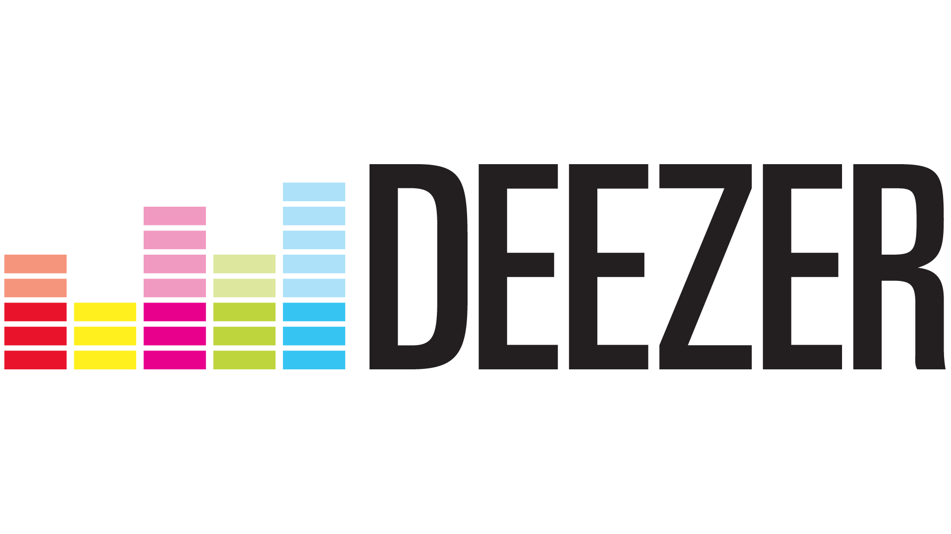






Slide 20








FROM WEB1 to WEB2
WEB 1
WEB 2
INDEX
SERVERS
APPS
Notes:
BIT MORE CLARITY ON PRIVATE NETWORKS OWNERSHIPS

Slide 21

THE MUSICIAN BUSINESS MODEL TODAY
PROFIT
AGGREGATORS
(Spotify etc.)
PRODUCTION
SERVICES
MANUFACTURERS
CMO
DISTRIBUTORS
(Tunecore, Distrokid etc.)
AUDIENCES
CONTENT
MUSICIANS
LOSS
Notes:
TO BE WORKED OUT →. CONCLUSIONS

Slide 22
GATE-KEEPERS
MUSICIANS
LABELS
AUDIENCES
Notes:
THIS IS WHERE WE START TALKING ABOUT BLOCKCHAIN

Slide 23
WEB 3

Slide 24
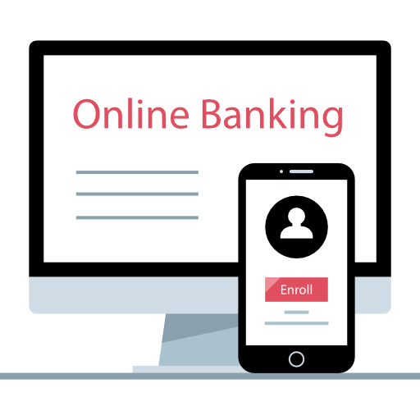
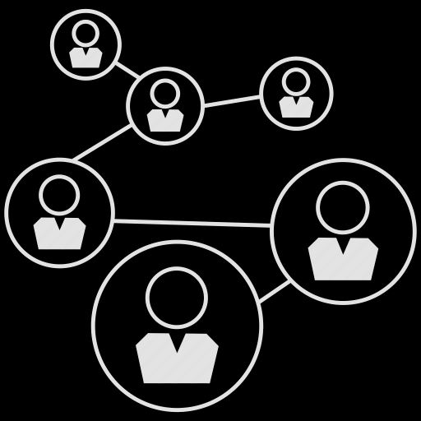

FINANCE EVOLUTION
WEB 2
WEB 3
PROFILE
ACCOUNT
ACTIVITY
TXNs
PROFILE = ACCOUNT
ACTIVITY = TXNs
Notes:
Small time project - ask your aunt.
DIFFERENCE BETWEEN ICO AND DEFI
ICO → I buy equities on-chain (stock market open to everyone)
DEFI → on blockchain there are no banks, where do I put my money to generate interest? There are different solutions.
DeFi allows people to store their cryptocurrencies and generate interest. An On-chain company might run a similar
Service and pay back stakers with equities.
DeFi allows exchange between tokens

Slide 25
FUNDING EVOLUTION
Traditional
Kickstarter Model
WEB3 / Crypto
Corporate/
Startup
Corporate/
Startup/
Small time
Corporate
STOCK MARKET
EQUITY CROWD
FUNDING
NFT sales
COIN sales
Decentralized
Finance (Uniswap)
Startup
ANGEL INVESTOR
Small Time
Small Time
FRIENDS & FAMILY
CROWD
FUNDING
Notes:
Small time project - ask your aunt.
DIFFERENCE BETWEEN ICO AND DEFI
ICO → I buy equities on-chain (stock market open to everyone)
DEFI → on blockchain there are no banks, where do I put my money to generate interest? There are different solutions.
DeFi allows people to store their cryptocurrencies and generate interest. An On-chain company might run a similar
Service and pay back stakers with equities.
DeFi allows exchange between tokens

Slide 26
BANK STATEMENT
BLOCKCHAIN
Date | Description | Debit | Credit | Balance
25/5/21 | payment | 6 |  | 300
26/5/21 | withdraw | 3 |  | 297
29/5/21 | deposit |  | 10 | 307
1/6/21 | payment | 5 |  | 302
txn | From | To | Value | Data
0xa | 0x8934 | 0xb345 | 6 | bytecode
0xa5 | 0xc8a7 | 0xba52 | 0 | bytecode
0xa5 | 0xe7f32 | 0x485c | 8 | bytecode
0xa6 | 0xb339 | 0x90d3 | 0 | bytecode
Notes:
bank statement is p2p, blockchain can be person to contract
how this is implied with certification?
show etherescan
Bank Statement is A leger or spreadsheet where:
you can’t alter a row to give yourself more cash
organized by date/time
the dates organized by month
private to the bank
BC is A leger or spreadsheet where:
you can’t alter a row to give yourself more cash or double spend
organized by transaction number
the txns organized by blocks
public to everyone (but anonymous) → how do NGOs guarantee donors’ privacy

Slide 27
Txn From To Value Data
0xa4...
Luigi
Frank
1
0xa5...
Alice
Bob
0.5
0xa6...
Bob
Sam
2
0xa7...
Chiara
Contract
0
Vote for #1
Block
0xa8...
Serena
Contract
0
NFT minting
0xa9...
Carlo
Matteo
12.5
received
0xa10...
Leo
Contract
0
vote
Notes:
A spreadsheet where:
you can’t alter a row to give yourself more cash
organized by transaction number
the txns organized by blocks

Slide 28

→ ADDRESSES
0x31f3733FF3CAe3E9c58D6100819D61Bea991CDA2
A Human (probably)
0xd65cb247e2387b1c817433c5e1e74166bb31774e
Smart Contracts

Slide 29
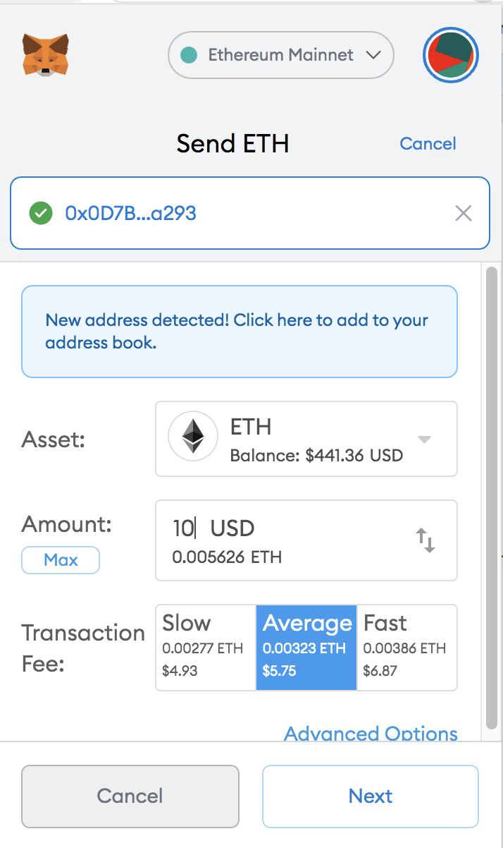
→ ETHER
(ETH)
NATIVE TOKEN OF THE ETHEREUM BLOCKCHAIN
WHAT REQUIRES ETH:
SAVING INFORMATION (e.g. send ETH or tokens)
COMPUTING (e.g. counting votes on a smart contract)
GAS (IN ETHER) GUARANTEES THE OVERALL SAFETY AND EFFICIENCY OF THE NETWORK:
GAS UNIT (quantity of gas needed to run a transaction)
GAS PRICE (per unit, depending how busy is the network)
GAS AMOUNT (depends on how complicated is the function)
** GAS & TRANSACTIONS GETS MORE EXPENSIVE WHEN THE NETWORK IS BUSY **
= HACKING THE BLOCKCHAIN IS TOO EXPENSIVE TO BE WORTH IT
Notes:
SAFETY - stops people from guessing your password - because it is too expensive. Forces the code to be efficient.
“GAS” - A UNIT TO MEASURE COMPARATIVE COMPLEXITY
MINING

Slide 30

WHAT CAN YOU STORE ON THE BLOCKCHAIN?
VALUE (ETH)
SMALL FILES
ADDRESSES
LARGE FILES
SOME DATA
SMART CONTRACTS
Notes:
BLOCKCHAIN are good for storing small bits of info that need to be:
Small files (<50kb)
A hash of a song / art piece
Wallet Addresses (hashes)
A smart contract
Good for recording small pieces of info that should not be altered and that should be publicly accessible.

Slide 31
LOCATION ADDRESSING vs CONTENT ADDRESSING
URL query
HASH query
Notes:
Availability : If the central server fails no-one is going to get any required resource in the case of location based addressing. Opposite to this if we are using content based addressing resource is stored decentralized and searched by resource id (CID) so if any node in decentralized network has the resource we can get it.
Security : We can't guarantee the resource we asked for and the resource we are getting are always the same i.e. if we asked for a rose we can't guarantee that we got is rose. In content based addressing the content that is rose itself is used for addressing and is hashed and the hash value used for comparing the resource is exactly what we asked.
Redundancy : Redundant data gets stored many times (e.g. when we download the same file twice it creates file, file(1)). Which does not happen in content based addressing as content is the same it will generate the same hash value so will get stored only once.

Slide 32






WEB2 APP
CREATOR
content
AGGREGATOR
premiums + metadata
AUDIENCE
Storage
Metadata
Ledger
%
content
ALL information is hold by Aggregator
ALL decisions are taken by Aggregator
Notes:
Aggregator the middleman - is in control

Slide 33


WEB3 DAPP
storage
storage
storage
IPFS
BLOCKCHAIN
CREATOR
address + content
ETH / tokens
AUDIENCE
proof
ownership
address
DAPP
(SmartContract)
TOKEN HOLDERS
ALL information is public
ALL decisions can be voted, programmed on and computed by Smart Contracts
Notes:
The rules of the smart contract dictate who is in control
Funds can be sent from audience directly to the creator - or from audience to creator via the smart contract.
What could be the Architecture of BLOCKCHAIN based music app?
BLOCKCHAIN-> consensus over content
IPFS -> storage of content
ROYALTIES can be managed via: DividendContracts, UJODapp, MicroPayments, Patrons (Adv)
Spotify decides the value of a stream
On blockchain -> you can sell license,
If I have IPFS hash - then
Or centralize storage
DISCUSSION: what could be model of a web3 music app

Slide 34

→ SMART CONTRACTS
Example 1
I am a shepherd and I have sheeps.
I want to save my sheep in a list that shows I own it and to put this list in the public.
Only me can transfer ownership to someone else.
If I registered the sheep with my city, I would have to trust the city’s record keeper & their servers.
No one can transfer ownership but me - and once I do I cannot get it back unless the new owner transfers it back to me.
Fluffy
0x05854cA140caB11e2f5AAb284c6AB5415f96E26B
Bob the Shepherd
Notes:
Why trust the record keeper? -
Why trust state’s computers?
A smart contract is a small program that organizes stuff according to a set of rules if then statements
If I am the owner then I can delete a sheep.
If the sheep is being saved to a smart contract that associates the sheep with me - what needs to be on its collar?
Just “Fluffy”? Or Fluffy & my eth addr? Or Fluffy, my eth addr and the dapp url?
If the sheep is an NFT, then the token contract will have its owner.
Why not save this on my own database or the cities leger of sheeps & shephards?
Stuff can be saved on blockchain
Connections between stuff in real life (IRL) & blockchain
Fluffy examp

Slide 35



→ SMART CONTRACTS
Example 2: Programmable Voting
VOTING RULES
When can people vote
Who can vote
RECORDING VOTES
immutable proof of vote
PROGRAMMABLE: “IF… THEN...”
A proposal has passed and something can be triggered.
Direct implementation of what you have voted for
Notes:
Online voting is tricky because:
You want it to be sure only qualified people vote
You want votes to be anonymous
You want voters to be able to prove to themselves that their vote was counted
You want to make their vote private.
You don’t want someone to sell their vote and to be easily able to show who they voted for to someone else.
Do you trust the state or the organization that counts the votes?

Slide 36
→. SMART CONTRACTS
Example 3: Programmable Money
SMART CONTRACTS CAN HOLD MONEY
DIVIDEND CONTRACTS: RULES SPLITTING UP REVENUES
ESCROW CONTRACTS: RULES FOR WHEN TO RELEASE THE MONEY
“I will pay you when you will have delivered…”
MULTI SIGNATURE WALLETS: RULES FOR HOW MANY VOTES ARE NEEDED TO SEND MONEY
“As a band, we decide together where to spend money”
Matteo, Rob, & Iuri own some money together. Each of us have an Ethereum Address. The money that we own together is sitting in the MultiSignature Wallet’s Smart Contract. In order to send some of our money to someone else, at least 2 of us need to agree to the transaction.
Notes:
To split up the royalties or dividends of a song
To hold money until something happens - which is like ebay.
To have a way for people to own money together

Slide 37
→ SMART CONTRACTS
Examples 4: Organizations
DAO: Decentralized Autonomous Organizations
Wallet
Voting
Payments
Rules / Governance
Example of a DAO website (Aragon)
Use Cases: Fan clubs etc.
Matteo, Rob, & Iuri own some money together. Each of us have an Ethereum Address. The money that we own together is sitting in the MultiSignature Wallet’s Smart Contract. In order to send some of our money to someone else, at least 2 of us need to agree to the transaction.
Notes:
Oracles

Slide 38
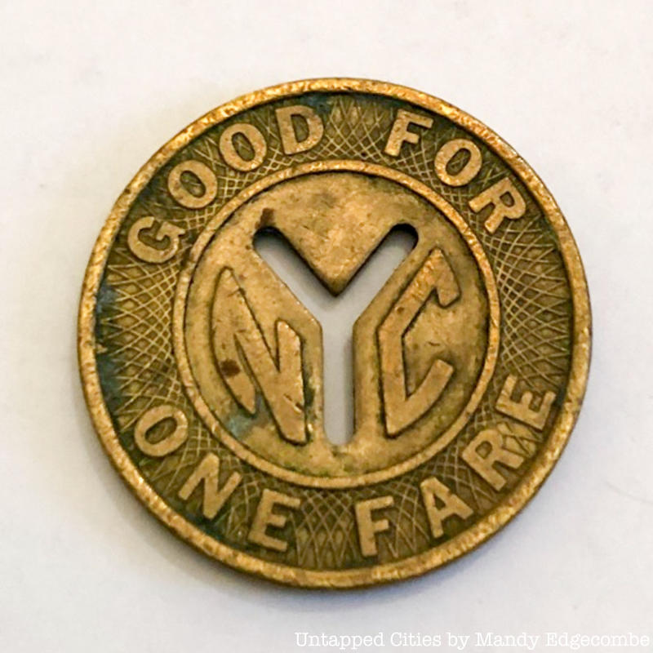
→ TOKENS
TOKEN
a thing serving as a visible or tangible representation of a fact, quality, feeling, etc.
a voucher that can be exchanged for goods or services, typically one given as a gift or forming part of a promotional offer
sometimes the token operates certain machines (laundry, arcade games, car wash etc)
Notes:
Caramelle as change when there were not enough 1 lira pieces ( I think)
https://www.bloomberg.com/news/articles/2019-06-15/italy-s-mafia-uses-the-old-lira-as-its-own-parallel-currency
Subway tokens
Frequent flier points
In the case of freq flier points there is a list of how many points all members have.
If I transfer some to my family ( following the freq flier rules - it takes them out of my account and into the family members account.
If I transfer money to you electronically - it works the same.
Disneyland token
Laundry token
Pinball token
Brixton Pound

Slide 39



→ TOKENS
ERC20 - make your own token
ERC20 FUNGIBLE TOKEN
Token Standard: predictability & interoperability
Lists of Value Holders’ Addresses (whitelists)
They are “fungible” and “swappable”
Can be used as voting power
can certify belonging to a community - e.g. https://spkz.io/
Notes:
Parallel local currency
Tomato token example
Similar to the Brixton pound
Community organzing & economics
Compensation chamber
Why should I get in debt to my bank to pay you if we live in the same local economic circuit?
I Sell veg, you are a carpenter - I need to borrow from bank
Or I can issue credit of vegetables that you can then use.

Slide 40
→ TOKENS
NFTs (ERC721)
ERC721 / ERC1155 NON FUNGIBLE TOKEN (NFT)
Each token is unique
The token can represent ownership of copyrights / royalties / licenses / kudos that the Author associated with the NFT
The Author can receive royalties every time the NFT is sold on the secondary market
QUESTION: What does it mean to own a digital thing?
Who owns it
NFT
Address of artwork on IPFS
Rules: eg: like 10% of resales go to original creator

Slide 41
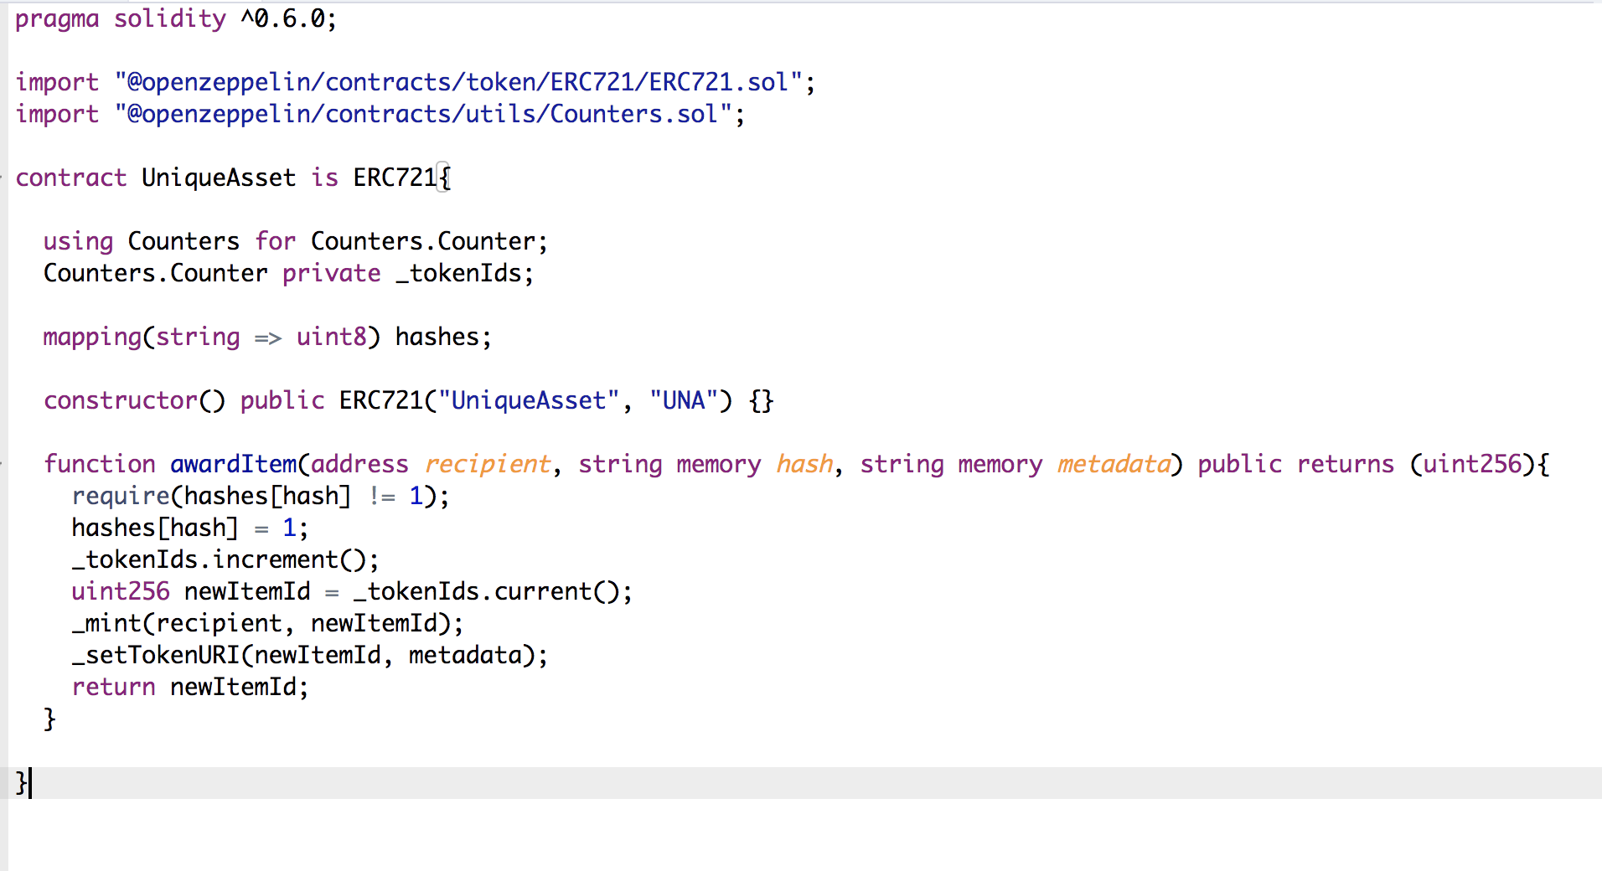
→ TOKENS
NFTs (ERC721)
SCREENSHOT OF RELEVANT PIECE OF CONTRACT FOR UNDERSTANDING
THE DNA OF AN NFT
Notes:
Then Demo of uploading to IPFS
https://pinata.cloud/pinmanager

Slide 42
→ TOKENS
NFTs (ERC721)
SCREENSHOT OF RELEVANT PIECE OF CONTRACT FOR UNDERSTANDING
THE DNA OF AN NFT
Notes:
Then Demo of uploading to IPFS
https://pinata.cloud/pinmanager

Slide 43
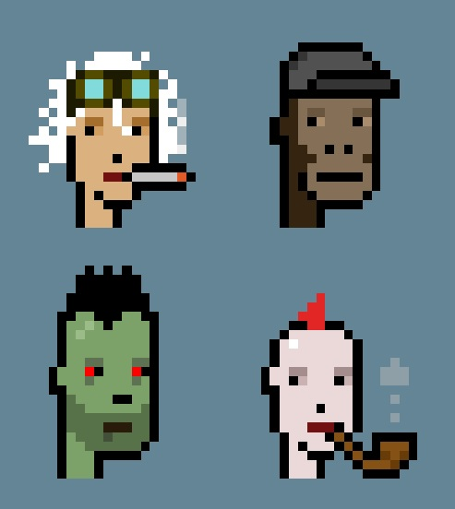

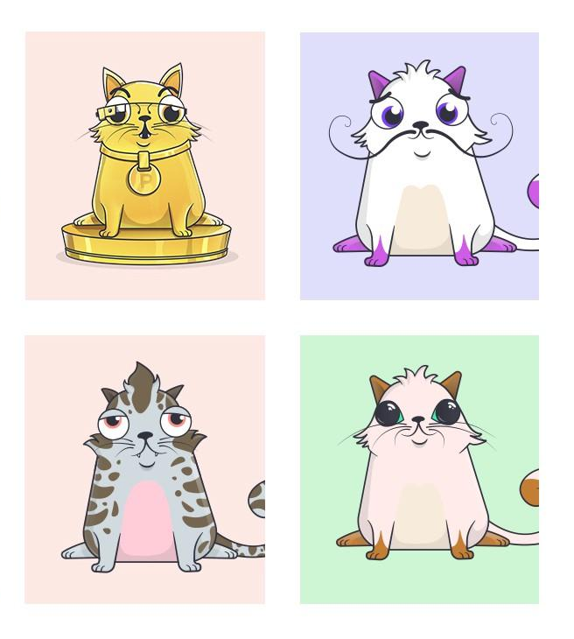
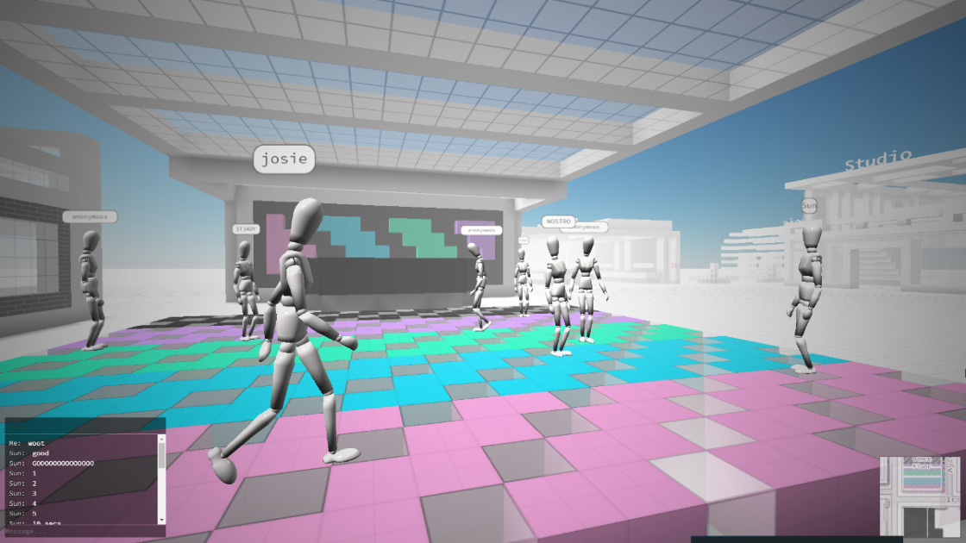

→ TOKENS
NFTs (ERC721)
Crypto Art
Collectables & Games
Crypto Kitties
Crypto Zombies
Crypto Punks
Music NFTs
Cryptovoxels (tokenizing lands and
Assets in the Metaverse)
Notes:
What does it mean to own a digital thing?
What does it mean to compose silence or display a upside down urinal and call it art and claim ownership?
Or on the scammy side - selling stakes in the moon? Its only worth the paper is printed on - but that paper can be imbued with value.

Slide 44
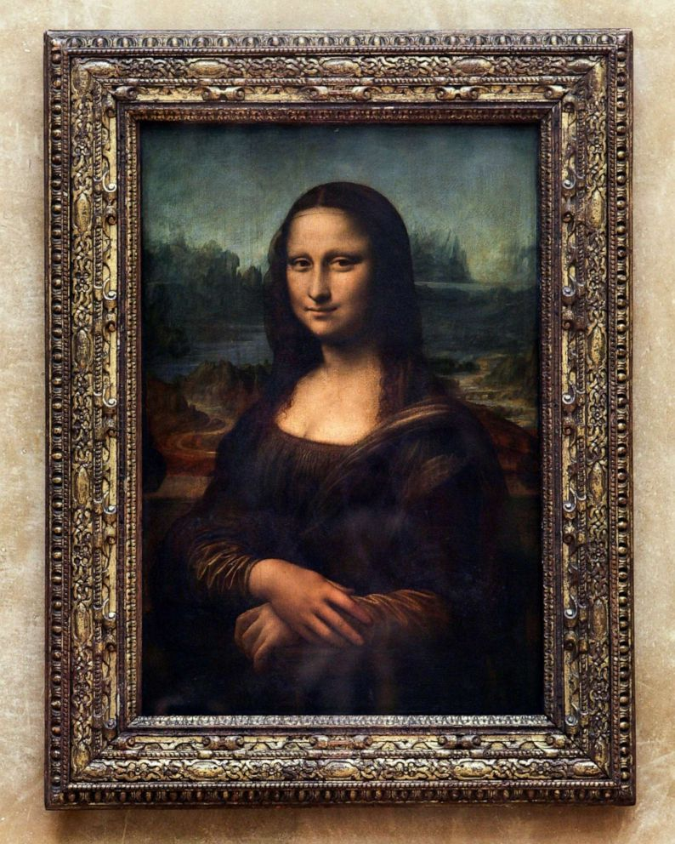
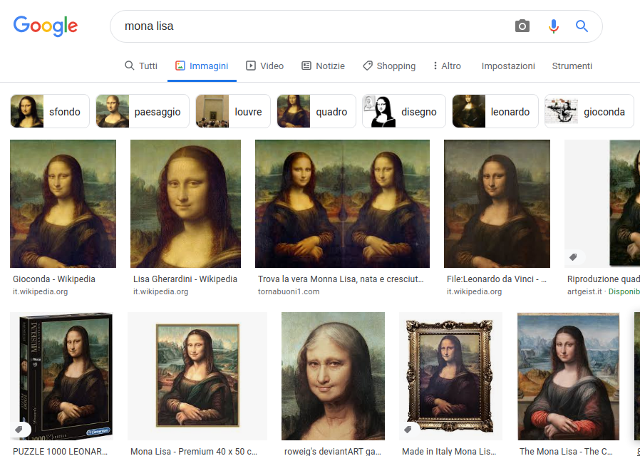
→ NFTs
NFTs: A CERTIFICATE OF OWNERSHIP
(that also shows who else has own it)
PHYSICAL
ONLINE (WEB2)
Notes:
This is in the public domain but is owned by the owner of the token?
PHYSICAL and NFT are BOTH direct products of the artist, not copies or pics.
With the NFT, the Artist stored the original on IPFS as unlockable content (only the owner has it) → GOOGLE CANNOT SEE IT IF IT’s NOT SHARED

Slide 45
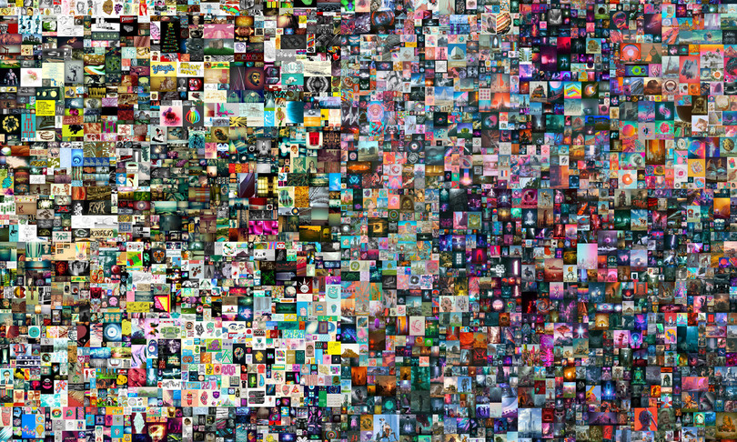
→ TOKENS
NFTs: OWNERSHIP
What does it mean to own a digital thing that is available on the internet?
Viewing the file on your computer is irrelevant
Possession of the file on your computer is irrelevant
The certificate of ownership (ERC721) is key
Ownership is regarded as a value by a community

Slide 46
QUESTIONS?

Slide 47
HOW CAN A LABEL GO ON-CHAIN?
agreements with artists immutability of contracts? upgradability multi-signature wallets | treasury payroll
funding | licensing, copyrights
ownership | distribution management

Slide 48
COPY PASTE YOUR
METAMASK ADDRESSES
IN CHAT, PLEASE!
Notes:
Music is the only industry based on an immaterial, invible content
lightweight, has social impact
compared to images and movies, allows multitasking (you listen to music while running, working, shopping, cleaning).
Copyright and royalties system connected to publishing is one of the oldest system (Mozart)

Slide 49
LUNCH BREAK!

Slide 50
DEMO TIME!
DIFFERENT WAYS TO
BUILD AN ON-CHAIN
MUSIC LABEL

Slide 51

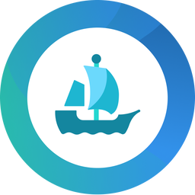
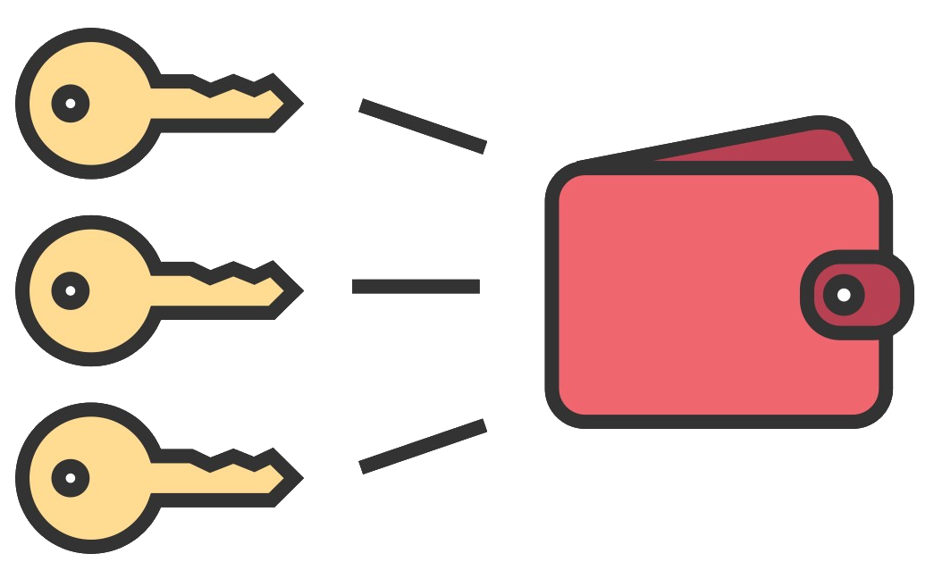
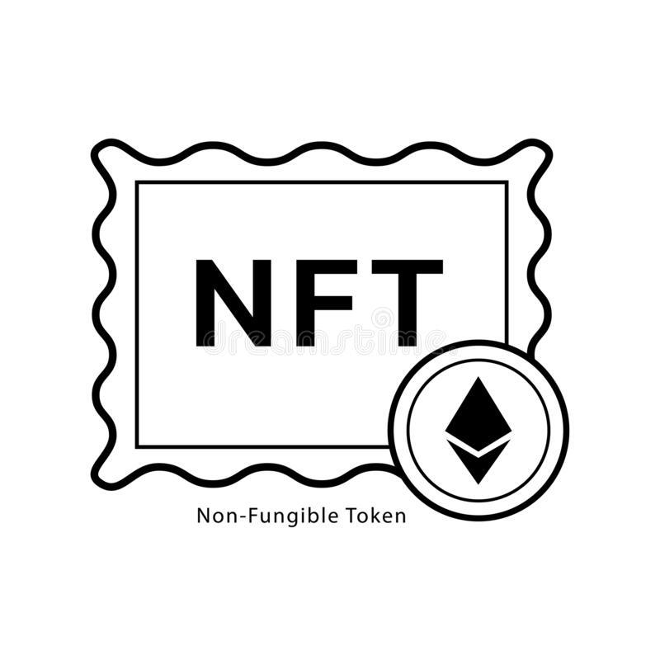
MULTISIG WALLETS
MULTISIG
NFT DAPP STOREFRONT
NFT CROWDSALE
OWNERS cannot change once the MultiSig has been set
Notes:
https://rinkeby.gnosis-safe.io/
https://testnets.opensea.io/

Slide 52
2) DAOs
NFT STOREFRONT
DAO
NFT CROWDSALE
ARTIST
$
$
DAO Wallets are bound to voting and consensus in order to send money to other addresses (members), and to allow new members in the DAO

Slide 53
3) DIVIDEND CONTRACTS (ERC20)
NFT DAPP STOREFRONT
DIVIDEND ERC20
NFT CROWDSALE
$
DIVIDEND contract does not require consensus, ERC20s ownership allows anyone to pull dividends from the Dividend Wallet. Dividend Tokens are freely transferable. Later on, off chain Consensus systems can be implemented on the token itself (e.g. Snapshot.org)

Slide 54
4) DAO + DIVIDEND (DAO reader)
NFT DAPP STOREFRONT
DAO
READER
DIVIDEND
NFT CROWDSALE
READER DIVIDEND contract reads the DAO token shares, it mints no extra tokens and allows DAO members to pull their dividends without need for consensus and voting

Slide 55
DEPLOYMENT ORDER
1
2
3
4
MUSIC LABEL DAO
CONTENT IPFS
NFT contract
CROWDSALE
CID (hash) → URI
Contract Address
ABI (code)
ERC20 govern token
DAO Wallet Address
5
DAPP

